Slide 1
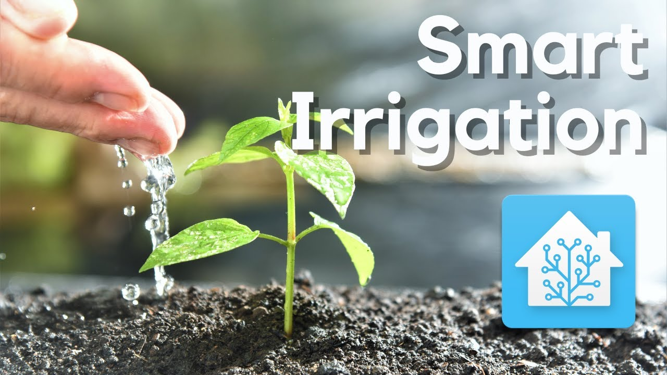

Slide 2



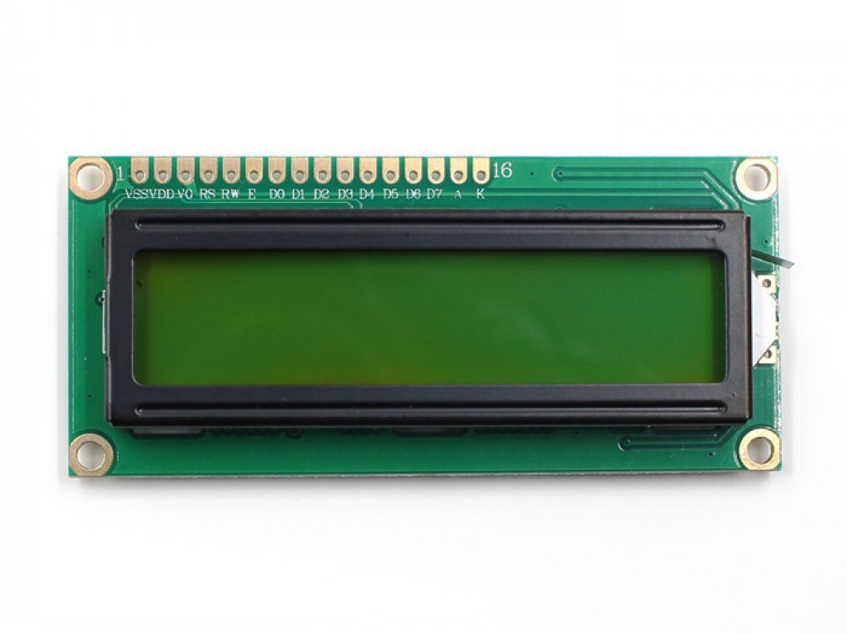
Components
Atmega32 Micro controller
Moisture Sensor
Ultrasonic Sensor
Lcd
Push button
Irrigation Pump
Tank filling Pump

Slide 3
START
unsigned char ON_FLAG=0
unsigned short int distance=0
unsigned int ovf_count=0
Float ticktime=(256.0/16000000.0)*1000
ON_FLAG=0 ?
Clear Display of LCD
Turn off Filling Pump
Turn off Irrigation Pump
Yes
No

Slide 4
No
Ultrasonic Read Distance
LCD write Distance in the first line
Distance > 100 ?
Distance < 50 ?
No
No
Yes
Yes
Turn on Filling Pump
Turn off Filling Pump

Slide 5
Read Moisture of the soil
LCD write Moisture in the second line
Moisture <= 20% ?
Moisture
>= 90% ?
No
No
Yes
Yes
Turn on Irrigation Pump
Turn off Irrigation Pump

Slide 6
How it works
The system turned on or off with a push button.
When the moisture sensor read that moisture of the soil less than or equal to 20% , The Irrigation Pump will be turned on until the moisture sensor read reaches 90% then turned off again.
When the ultra sonic sensor reads that the distance is more than 100 cm ( 1 meter),
The tank filling Pump will be turned on until the distance is less than 50 cm then turned off again.

Slide 7
Micro controller used features
interrupts
Timers
ADC converter

Slide 8
Interrupts
The on/off button is connected to an interrupt pin.
Also used an interrupt pin with the echo pin of the ultrasonic sensor to start and stop timer 0 in the rising and falling edge of the echo pulse.
Interrupt to start timer 0
Interrupt to stop timer 0

Slide 9
Timer 0
Timer 0 is used to measure the level of water by calculating the time of the echo pulse of the ultrasonic sensor.
Distance = (Time of pulse * speed of sound (340 m/s)) / 2
Start timer 0
Stop timer 0
Time of pulse = { overflow counts * No . of ticks ( 256 ) + Timer0 read } * Tick Time
Tick time=(Prescaler( 256.0 ) / one Tick Time (16000000.0) ) * 1000

Slide 10
ADC
ADC is used to read the analogue signal coming from the moisture sensor to be displayed on LCD.

Slide 11
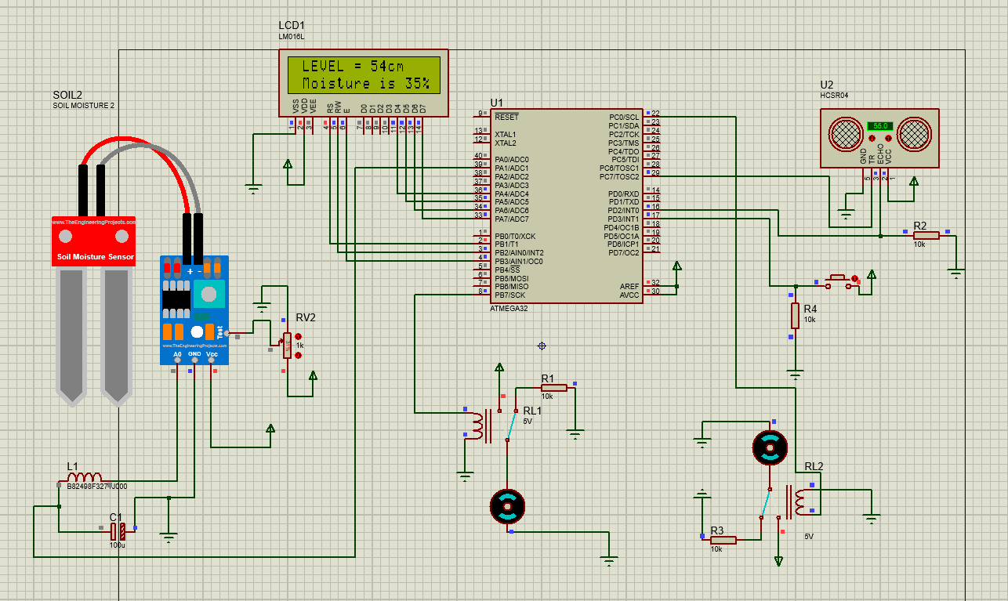
Tank Filling pump
Irrigation pump

